Slide 1

High Assurance Software with Bosque Mark Marron Microsoft Research November 2021
Scott Hazdra - Own work, CC BY-SA 3.0

Slide 2
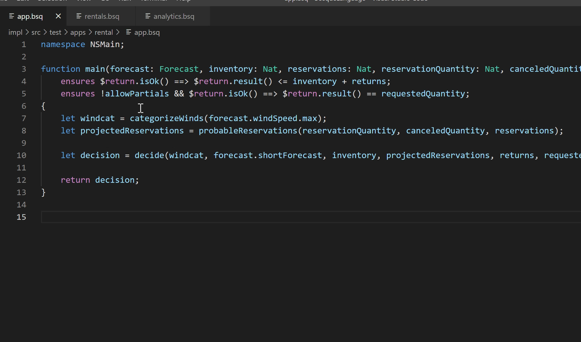

Slide 3
Parts of Bosque
Source language for writing high assurance applications
What language features make writing high assurance code easy?
What language features make automated reasoning easy?
Automated program reasoning and checker workflow
Use language features (and negative features) to simplify reasoning.
Create a robust software assurance workflow.
Service API specification for cloud native applications
What is a good API language for a polyglot/distributed computing world?
How can we use this language & reasoning address major pain points when building service based applications?

Slide 4
Bosque Language

Slide 5
A Walk Through the Bosque Language
Must be able to express rich computation (not a simple DSL)
Approachable by modern dev coming from C#/Java/TypeScript
Should be productive within a few days
No knowledge of proofs or additional specification language
Optimized for a cloud-centric distributed world!
Bosque borrows heavily from the functional family of languages
Careful design to support reasoning needs
Eliminate some common anti-patterns

Slide 6
Bosque Language Samples
function abs(x: Int): Int {
var sign = 1;
if(x < 0) {
sign = -1i;
}
return x * sign;
}
function allPos(...args: List<Int>): Bool {
return args.allOf(pred(x) => x >= 0i);
}
foo(1, 2, 3); //true

Slide 7
Verification Support
Program logic checks are fundamental to quickly catching bugs but explicit conditionals or custom libraries lead to suboptimal systems
function gcd(x: Int, y: Int): Int
requires release x > 0 && y > 0; //check is always done
ensures $return > 0; //only in debug/test build
{
...
}
function gcd(x: Int, y: Int): Int {
if (x < 0 || y < 0) {
abort;
}
...
if (Debug::postEnabled && v < 0) {
abort;
}
return v;
}

Slide 8
Data Invariants
entity CalendarEvent {
field name: String;
field location: String;
field Start: ISOTime;
field end: ISOTime;
...
}
entity CalendarEvent {
field name: String;
field location: String;
field start: ISOTime;
field end: ISOTime;
invariant $name !== "";
invariant $location !== "";
invariant $start < $end;
...
}

Slide 9
Typed Strings
typedecl ZipcodeUS = /[0-9]{5}(-[0-9]{4})?/;
function isNYCode(s: StringOf<ZipcodeUS>): Bool {
return s.value().startsWith(/1[0-4]/);
}
isNYCode('10001'#ZipcodeUS) //true
isNYCode('87111'#ZipcodeUS) //false
isNYCode("12") //type error not a StringOf<ZipcodeUS>
isNYCode('WC1E'#PostcodeUK) //type error not a StringOf<ZipcodeUS>
typedecl ZipcodeUS = /[0-9]{5}(-[0-9]{4})?/;
typedecl ZipcodeUS = /[0-9]{5}(-[0-9]{4})?/;
function isNYCode(s: StringOf<ZipcodeUS>): Bool {
return s.value().startsWith(/1[0-4]/);
}
isNYCode('10001'#ZipcodeUS) //true
isNYCode('87111'#ZipcodeUS) //false

Slide 10
Typed Numbers
typedecl Fahrenheit = Int;
typedecl Mph = Nat;
let a = 100#Fahrenheit;
let b = 99#Fahrenheit;
check a < b;
typedecl Percentage = Nat & {
invariant $value <= 100n;
}
let a = 100#Percentage;
let b = 101#Percentage; //Runtime Error
let p = a - 25#Percentage;
let q = a + 25#Percentage; //Runtime Error

Slide 11
Bosque Checker

Slide 12
Intermediate Representation for Reasoning
Traditionally intermediate representations were used in compilers to simplify mapping from source to efficient assembly
Verifiers, testing tools, refactoring systems, etc. all need to reason about IR behavior
Effectiveness of these systems is severely limited by foundational aspects in mainstream programming (IR) languages
Can we build core-language IR that, by design, excludes features that cause analysis problems?
What impact does this have on our ability to do program reasoning build practical/effective compilers and developer tooling?

Slide 13
Challenges to Deep Understanding
Why is deep understanding of code hard?
Loop/Inductive invariants
Mutable State
Identity and Equality
Non-determinism
These are long-standing research problems:
Mutable state and Invariants – Floyd/Hoare logic in 1969
Identity and equality – aliasing nearly 40 years of papers

Slide 14
Looping and Iterative Constructs
Can we really get rid of loops (and minimize recursion)?
In practice though most loops are really instances of a small set of common idioms:
Anecdotal evidence includes libraries like C# LINQ, Java Streams, lodash (JavaScript), etc.
Empirical evidence arrived in 2018 with “Mining Semantic Loop Idioms” by Allamanis et. al.

Slide 15
BosqueIR => SMT Formula
By construction most BosqueIR constructs are 1-1 with SMT theories
Nat/Int => BitVector, Float/Decimal => Real, String => String, …
Tuples, Records, ADT => Theory of Constructors
Functions => define-fun
Collections => Constructors, Decidable QBVF, and Inductive Reduce
Technical details in our report:
Comprehensive Reachability Refutation and Witnesses Generation via Language and Tooling Co-Design
Happy to discuss more detail for those interested

Slide 16
Checker Results
In an ideal world we would convert program to logical representation and prove every error impossible or produce a witness input
In the real world solvers timeout and induction heuristics fail
The Bosque approach is to embrace this and succeed even when things fail
Strive for succuss
Resilience on failure
Hierarchy of confidence boosting results :
1a. Proof that the error is infeasible on all possible executions
1b. Feasibility witness input that triggers the target error
2a. Proof that the error is infeasible on a simplified set of executions
2b. No witness input found before search time exhausted

Slide 17
Error
Input Size
&
Number Bitwidth
Small Refute
Yes
Full
Refute
Yes
1a Success
No
No
&
2a Success
Large Witness
No
Small Witness
Input Size
&
Number Bitwidth
No
Yes
Yes
2b Success
1b Success

Slide 18
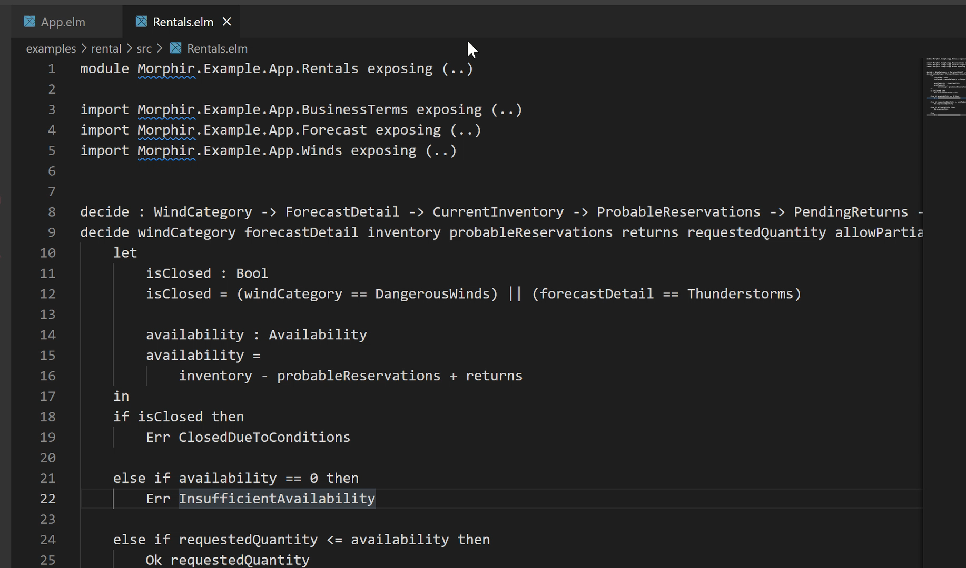

Slide 19
Cloud APIs with Bosque

Slide 20
The Future of the Cloud is APIs
We want to build a rich software ecosystem for the cloud
This needs some sort of API language to enable
Consumption, creation, discovery, execution, and lifecycle management
Existing tooling is flexible but fundamentally limiting
Error prone to use and limited tooling for consumption/production
New challenges when dealing with service based architectures
Polyglot environment, testing environment, versioning

Slide 21
NWS Inspired Forecast (TypeScript)
type Forecast = {
"temp": {low: number, high: number},
"windSpeed": {min: number, max: number},
"windDirection": CompassDirection,
"shortForecast": string,
"forecastPercent": number
};
@service
function getForcast(city: string): Forecast;

Slide 22
NWS Inspired Forecast (Bosque)
typedecl Fahrenheit = Int;
typedecl Mph = Nat;
typedecl Percentage = Nat & {
invariant $value <= 100n;
}
type ForecastBSQ = {
temp: {low: Fahrenheit, high: Fahrenheit},
windSpeed: {min: Mph, max: Mph},
windDirection: CompassDirection,
shortForecast: String,
forecastPercent: Percentage
};

Slide 23
NWS Inspired Forecast (Bosque)
const forecastType: Regex = /Showers|Thunderstorms|Snow|Fog/;
typedecl ForecastDetail = /${forecastType} (And ${forecastType})?/;
type ForecastBSQ = {
temp: {low: low: Fahrenheit, high: Fahrenheit},
windSpeed: {min: Mph, max: Mph},
windDirection: CompassDirection,
shortForecast: StringOf<ForecastDetail>,
forecastPercent: Percentage
};

Slide 24
Forecast – Pre-conditions
type ForecastBSQ = {
temp: {low: Fahrenheit, high: Fahrenheit},
windSpeed: {min: Mph, max: Mph},
windDirection: CompassDirection,
shortForecast: StringOf<ForecastDetail>,
forecastPercent: Percentage
};
function getForecast(city: String): ForecastBSQ
requires city !== "";
;

Slide 25
Forecast – Post-conditions
type ForecastBSQ = {
temp: {low: Fahrenheit, high: Fahrenheit},
windSpeed: {min: Mph, max: Mph},
windDirection: CompassDirection,
shortForecast: StringOf<ForecastDetail>,
forecastPercent: Percentage
};
function getForecast(city: String): ForecastBSQ
requires city !== "";
ensures $result.temp.low < $result.temp.high;
ensures $result.windSpeed.min < $result.windSpeed.max
;

Slide 26
Forecast – DataType
entity ForecastBSQ provides APIType {
field temp: {low: Fahrenheit, high: Fahrenheit};
field windSpeed: {min: Mph, max: Mph};
field windDirection: CompassDirection;
field shortForecast: StringOf<ForecastDetail>;
field forecastPercent: Percentage;
invariant $temp.low < $temp.high;
invariant $windSpeed.min < $windSpeed.max;
}
function main(city: String): ForecastBSQ
requires city !== "";
;

Slide 27
Specs with Automated Reasoning
Suppose I build a travel app that gets weather, suggests activities, and books a surfboard
Bosque makes very clear how to use APIs correctly
How do I test my new service?
Live data
Build test deployment
Write mocks by hand
“Test in production”

Slide 28
Bosque Mock Generator
Pre and Post conditions are Bosque code
Bosque code is convertible to a decidable fragment for FOL
Can “solve” for an output value given an input using SMT solvers (Z3)
Instead of hand implementing mocks
Use solver to generate mock results on demand
Can tune for “natural” values, failures, or “odd” results
Fully deterministic, locally executable, and can be saved/regenerated as needed!

Slide 29
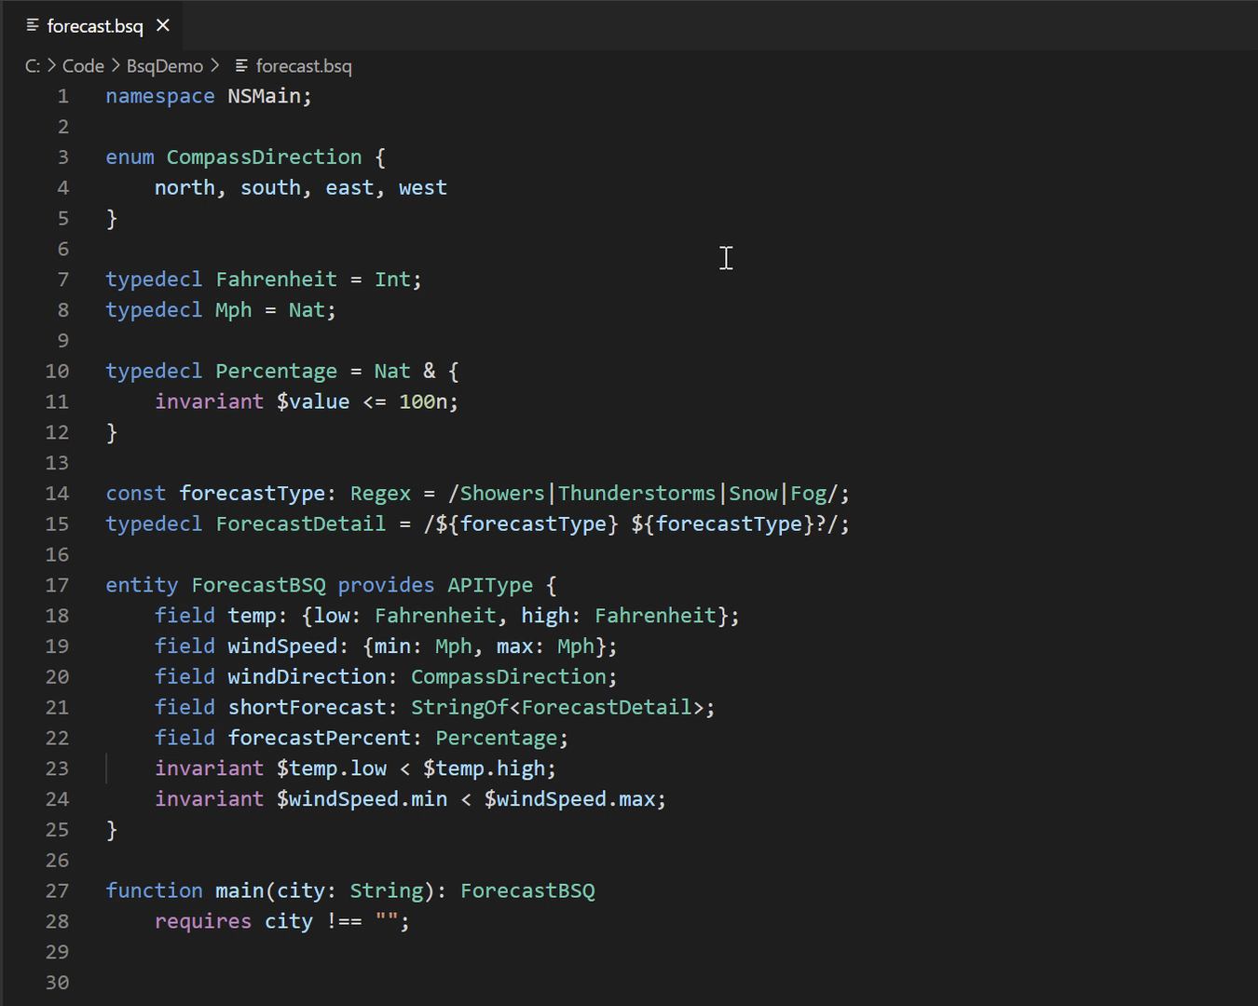

Slide 30
Conclusion
Bosque is a new paradigm in programming languages and design
Language + Reasoning Co-Design as a core principle
Features selected for Automated (and human) Reasoning
Bosque IR enables the deep understanding of a software artifact
Takes a tooling first view for IR design
Excludes features that make reasoning difficult
Bosque Language provides high-agility dev experience
A high-productivity dynamic language for the core IR that also introduces novel language features like Typed Strings and API Types
New way to think about defining and working with Cloud Services and APIs

Slide 31
References
https://github.com/microsoft/BosqueLanguage
“High Assurance Software for Financial Regulation and Business Platforms” – to apprear at VMCAI 2022
“Comprehensive Reachability Refutation and Witnesses Generation via Language and Tooling Co-Design” – Technical Report

Slide 33
BosqueIR => SMT Formula
By construction most BosqueIR constructs are 1-1 with SMT theories
Nat/Int => BitVector, Float/Decimal => Real, String => String, …
Tuples, Records, ADT => Theory of Constructors
Functions => define-fun
(define-fun min_int((x BInt) (y BInt)) BInt
(let ((@tmp_0 (bvsle x y)))
(ite @tmp_0
x
y
)
)
)

Slide 34
Collections are Hard
If no loops (and recursion is discouraged) then how to process collections?
Use functors (or comprehensions) to cover most common operations
map, filter, findIndex, allOf, fill, sort, join, …
Challenge is to define (hopefully decidable) theory for these operations
+ Only a finite set with known semantics so we can encode – one and done
- Still reasoning over symbolically bounded structures so can’t finitize directly like other Bosque features

Slide 35
Many Ops as Constructors & Destructors
type List =
const_3 of Int * Int * Int
| fill of Int * Int
| append of List * List
| map[f] of List
function allOf[p](l) =
const_3(x, y, z) => (and p(x) p(y) p(z))
| fill(c, v) => p(v)
| append(l1, l2) => (and allOf[p](l1) allOf[p](l2))
| map[f](lp) => \forall n, n < size(lp) => p(f(get(lp, n)))

Slide 36
Quantifiers Still in Some Places ☹
Suppose we have:
List<Int>::range(s, e).allOf(fn(x) x > 0);
Can’t check single element – must ensure [p] holds on full symbolic range
BitVectors!
Use Nat (BitVector) as index for collections
All quantifiers over BV index values => logic in QBVF (decidable)
Can also generate models for failed verifications!

Slide 37
Block Scoping and Mutable Variables
Block scoping allows developers to chunk their work and helps linerarize flow.
Works best if variables can be reassigned – normally this breaks immutability but IR supports Single Dynamic Assignment (no loops) so we can rewrite to pure version!
function abs(x: Int): Int {
var sign = 1;
if(x < 0) {
sign = -1;
}
return x * sign;
}
function abs(x: Int): Int {
sign_0 = 1;
if(x < 0) {
sign_1 = -1;
}
sign_2 = φ(sign_0, sign_1);
return x * sign_2;
}

Slide 38
Ref Parameters
In addition to multi-return values Bosque also allows developers to automatically thread parameters via ref argument passing
function internString(ref env: Map<String, Int>, str: String): Int {
if(env.has(str)) { return env.get(str); } //use the ref parameter
env = env.add(str, env.size()); //update the ref parameter
return env.size(); //multi-return updated parameter
} ...
var env = Map<String, Int>@{};
let nameid1 = internString(ref env, "hello");
let nameid2 = internString(ref env, "goodbye");
_debug(env.toList()); //List<[String, Int]>@{ ["hello", 0], ["goodbye", 1] }
function internString(env: Map<String, Int>, str: String): Int, Map<String, Int> {
if(env.has(str)) { return env.get(str); }
let envp = env.add(str, env.size());
return envp.size(), envp;
}
...
var env = Map<String, Int>@{};
let nameid1, env1 = internString(env, "hello");
let nameid2, env2 = internString(env1, "goodbye");
...

